Slide 1
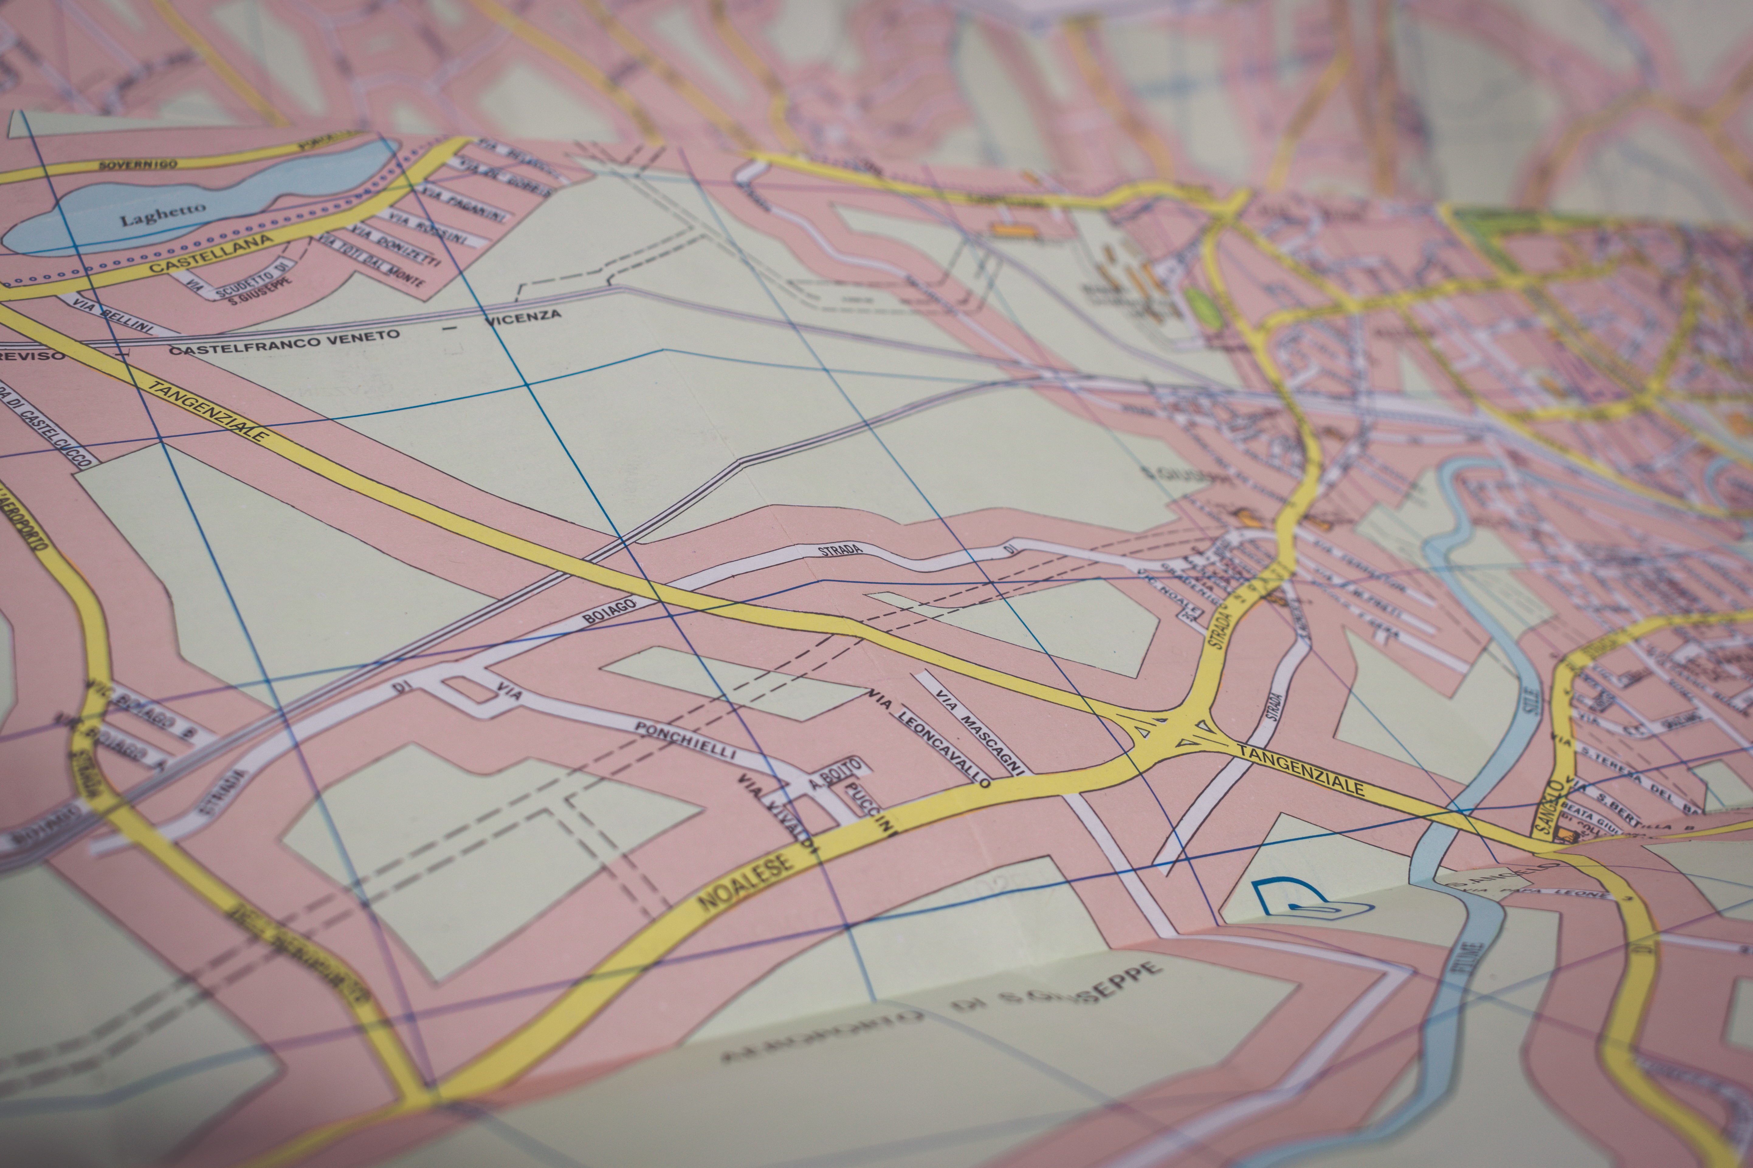

Bar-Pop
Mobile Application for Bar Populations
System Architecture, Design, and Interaction Diagrams

Slide 2
Revised Actor and Goals
Actors | Goals
Venue-Hopper | To register or log into an account, and to obtain venue information.
Venue-Owner | To obtain information about their venue and to edit information about the venue they own. This includes adding, removing, or modifying events.
Manager | To manage accounts and approve user privilege requests. To add and edit venue locations, events, and to obtain population and user statistics about the system. To manage advertisements and view statistics about the app, its events, and ad revenue.
Person Sensor | To detect and notify the system when a person has entered or exited a venue.

Slide 3
Casual Use Case Casual Descriptions
UC7 - Modify Event: To modify information about an event or remove it.
UC8 - Add Venue: To create a new venue.
UC9 - Manage Venue: To modify any information about venue or to remove it.
UC10 - Approve Privileges: To approve or decline registration privileges requests.
UC11 - Manage Advertisements: To add, edit, or remove advertisements in the app.
UC12 - View Statistics: To obtain app usage, ad revenue, and event statistics.
UC1 – Register: To create an account and request privileges.
UC2 – Login: To log into a registered account.
UC3 – View Map: To populate the map displayed to users with nearby venues.
UC4 – View Venue Information: To obtain event and population information of a venue.
UC5- Update Population: To get the population of a specific venue.
UC6 – Add Event: To create an event for a specific venue.

Slide 4
Fully Dressed Use Case Excerpts
UC11 – Manage Advertisements
Initiating Actor | Manager
Actor’s Goal | To add, remove, or edit advertisements
Participating Actors | Manager
Preconditions | Manager is logged in and has access to the website. Advertisers want to advertise in the app or an advertising platform provides ads to be used.
Postconditions | An advertisement is added, modified, or removed from the app.
Main Success Scenario
1 | Manager selects manage advertisements option
2 | System checks user privileges and if they match that of manager, system returns existing advertisements
3 | Manager selects to add, remove, or modify an advertisement
4 | System requests ad information from user for add or modify ad option. If remove option, system removes the add and sends confirmation message
5 | User adds or modifies the advertisement and submits the information to the system
6 | The system updates the advertisement and returns a success notification
UC1 – Register
Initiating Actor | User (A Venue-Hopper or Venue-Owner included by extension)
Actor’s Goal | To create an account that allow the user to view or do things based on granted privileges
Participating Actors | Venue-Hopper, Venue-Owner, and Manager
Preconditions | User has an email address, access to the app, and an internet connection.
Postconditions | User is registered in system and privilege are pending approval by manager if they were requested
Main Success Scenario
1 | User selects the register option
2 | System requests required user information including privilege requests
3 | User fills out required information and submits the information to the system
4 | System verifies and stores information and sends a confirmation email to user
5 | User confirms their email address
6 | System shows success notification and sends privilege request notification to manager

Slide 5
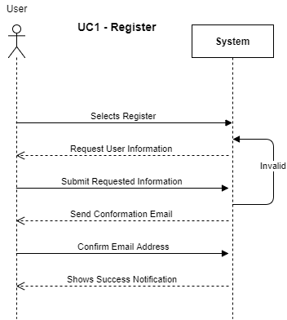
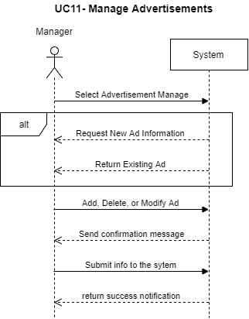
System Sequence Diagram Excerpts

Slide 6
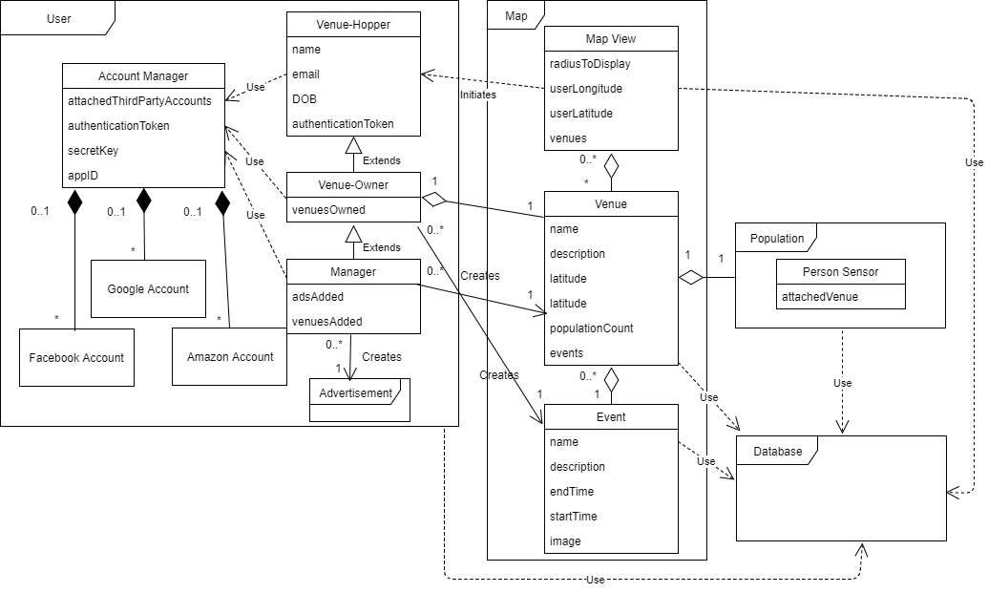
System Domain Model

Slide 7
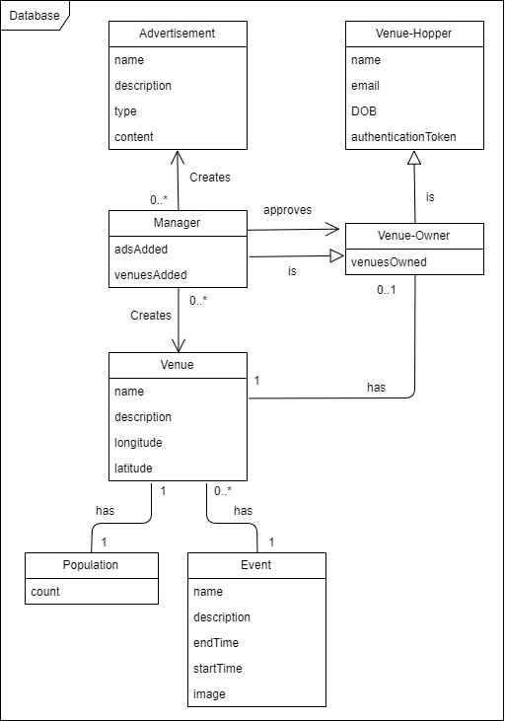
Database Model

Slide 8
Architecture Styles
Since our application is largely focused on fetching and providing information that is stored on a server in a database, our architecture pattern is most accurately captured by the client-server pattern. There is the possibility of thousands of clients that will all access our server, each with their own hardware connecting to and request information from our hardware (our server).
On each user’s phone or web-browser, they can access our application’s views. There are models that drive these views, however most of the models interaction involves querying the server. In this way, our method of processing data on the application and feeding the information to a view reflects that of the model-view architecture.

